Slide 1
Kingdom: Plantae
Cell type: Eukaryote
Cell structures: Cell walls of cellulose; chloroplasts
# of cells: Multicellular
Nutrition: Autotroph
Examples: Mosses, ferns, flowering plants

Slide 2
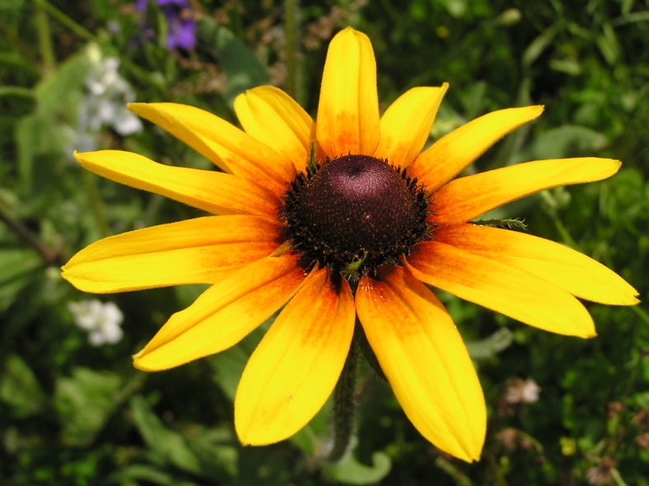
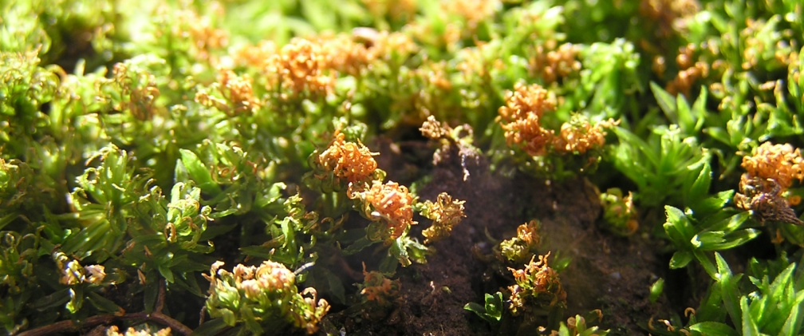
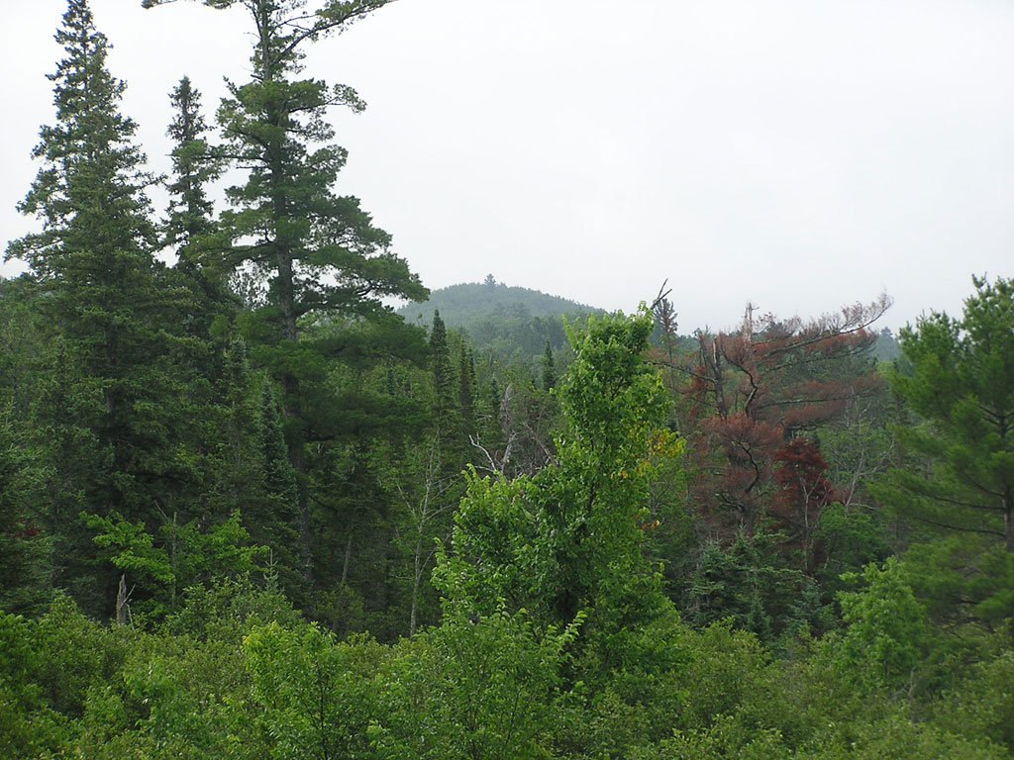
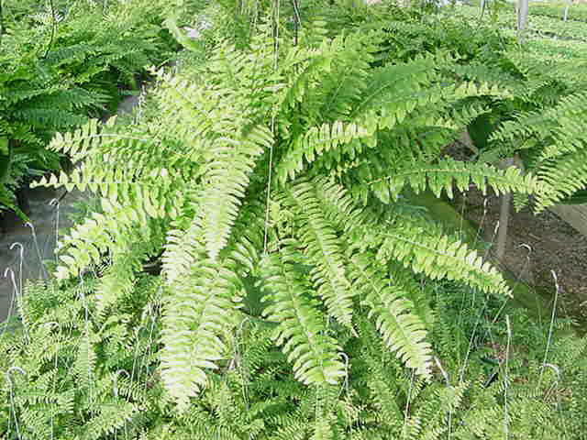

Slide 3
Kingdom: Animalia
Cell type: Eukaryote
Cell structures: No cell walls or chloroplasts
# of cells: Multicellular
Nutrition: Heterotroph
Examples: Sponges, jellyfish, sea anemones, worms, insects, fishes, mammals, birds, reptiles, amphibians

Slide 4
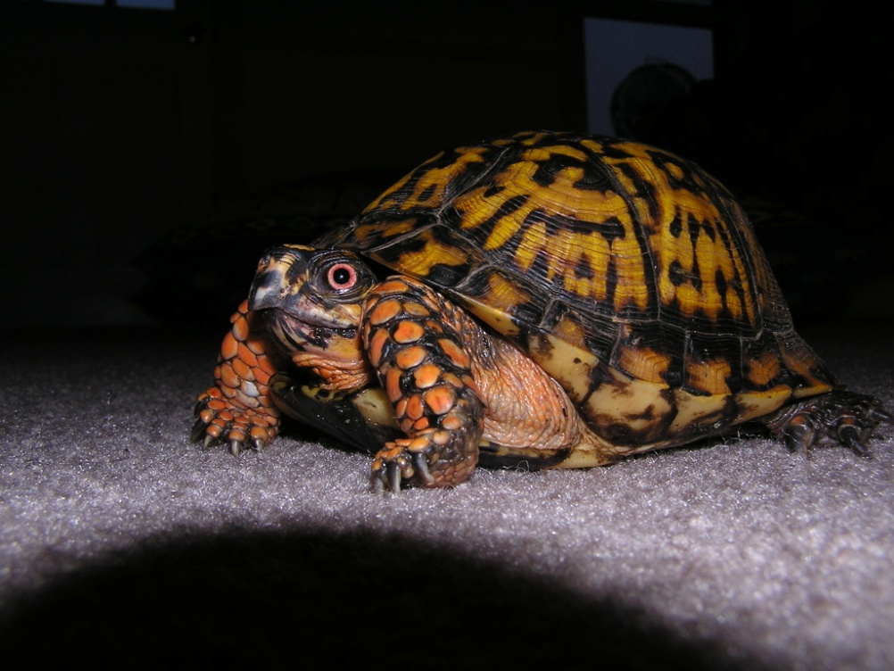
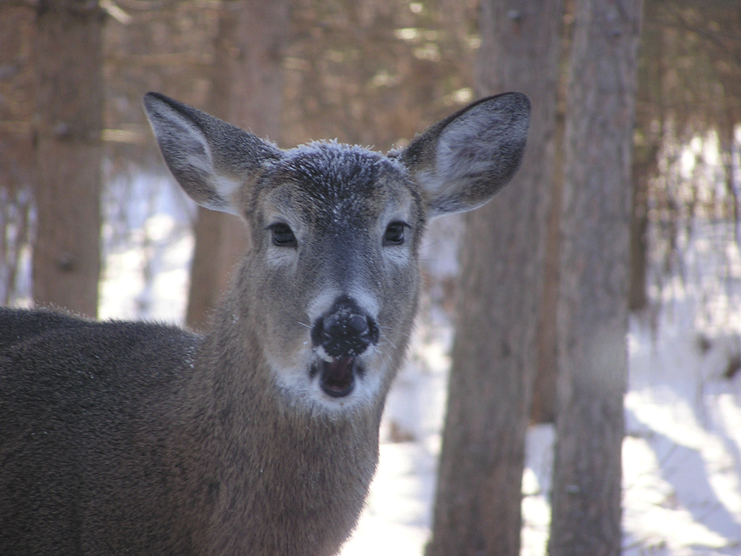
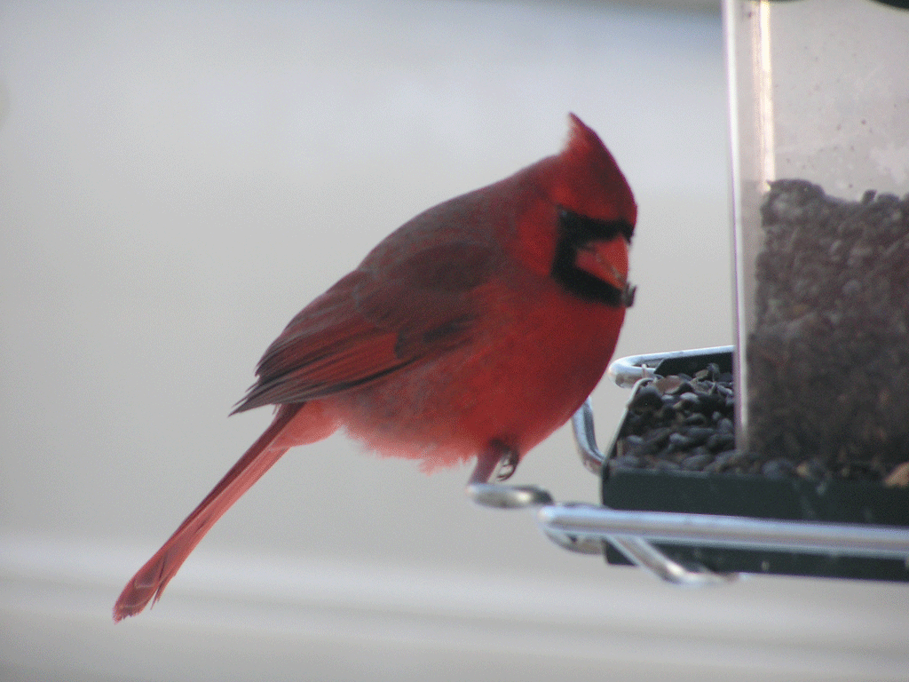
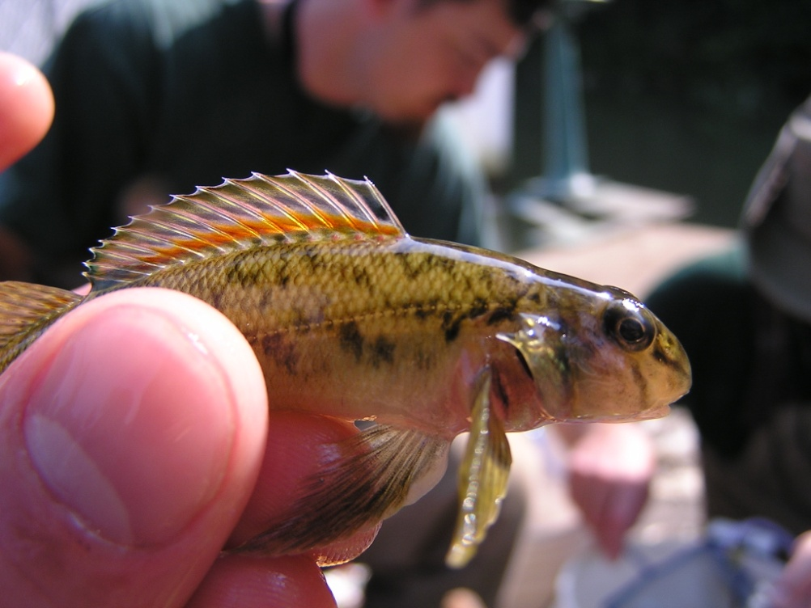

Slide 5
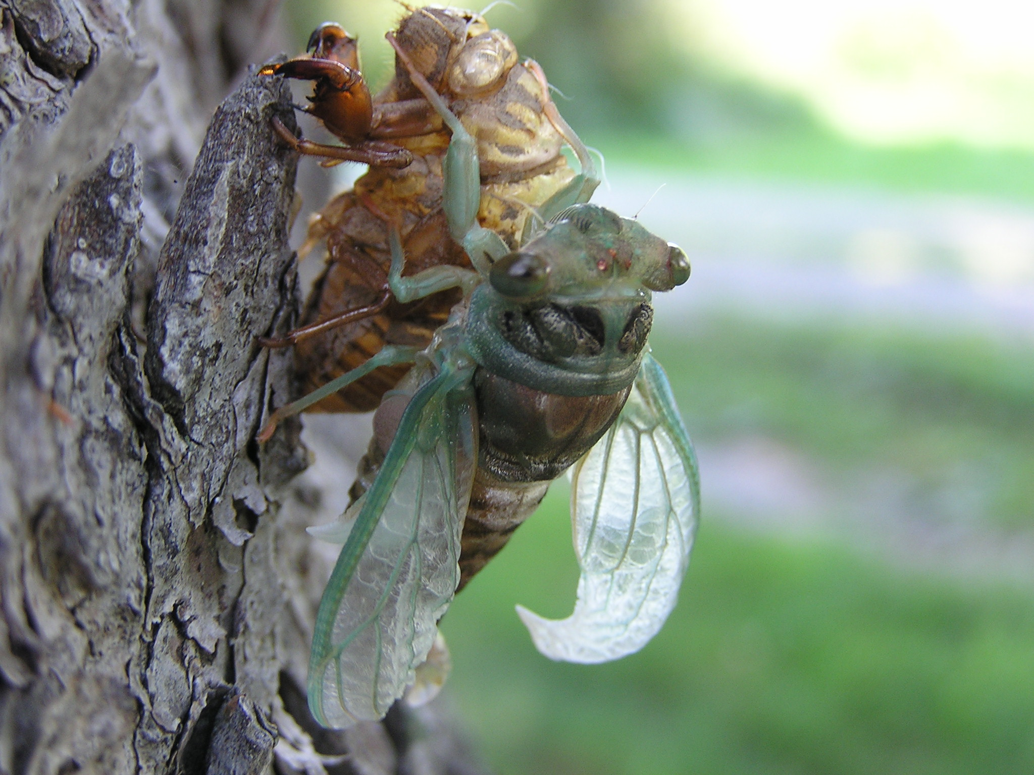

Slide 6
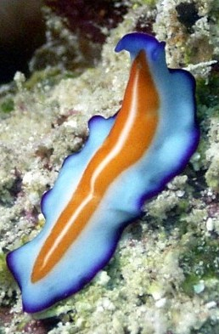
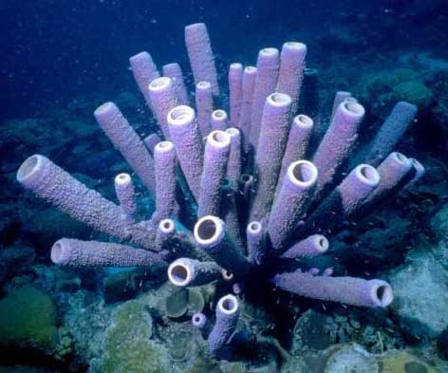
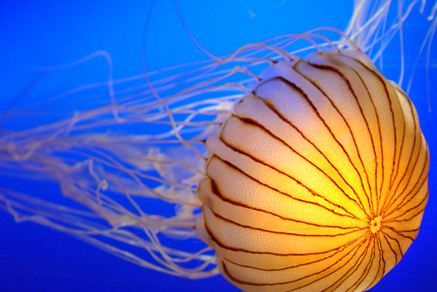
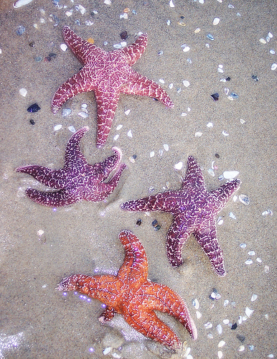

Slide 7
Living Things
Prokaryotic cells
are characterized by
Eukaryotic cells
Important characteristics
and differing
which place them in
Cell wall structures
Domain Eukarya
such as
which place them in
which is subdivided into
Domain Bacteria
Domain Archaea
Kingdom Plantae
Kingdom Protista
which coincides with
which coincides with
Kingdom Fungi
Kingdom Animalia
Kingdom Eubacteria
Kingdom Archaebacteria

Slide 8
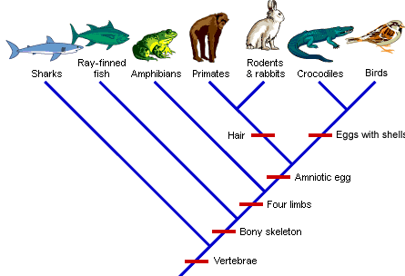
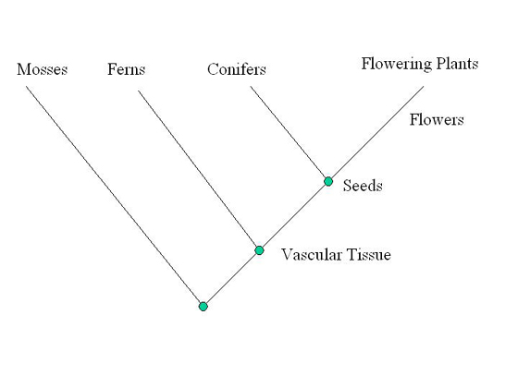
Cladograms
Determining evolutionary relationships
Which type of plant is most closely related to flowering plants?
CONIFERS

Slide 9
History of classification systems
Aristotle – Plants and Animals
Linneaus – developed BINOMIAL NOMENCLATURE
TWO KINGDOMS: plants and animals
THREE kingdoms: plant, animal, Protist
FIVE kingdoms: plant, animal, Protist, fungi, Moneran

