Slide 1
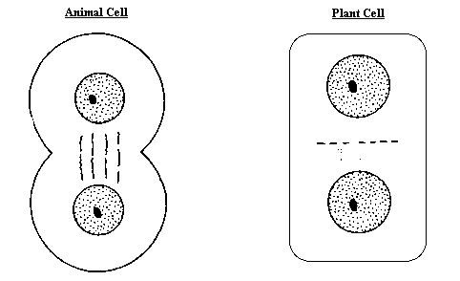
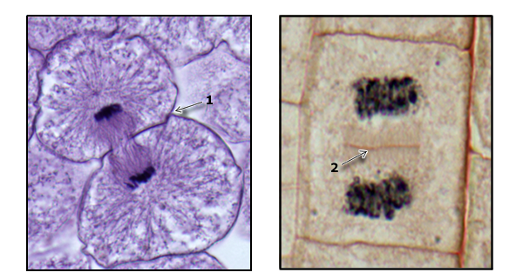
Cytokinesis
In animal cells the cell membrane drawn inward (cleavage furrow) and cytoplasm is pinched in two.
In plants a cell plate forms between the new nuclei and gradually develops into a new membrane. Cell wall then begins to appear.

Slide 2
Cytokinesis

Slide 4
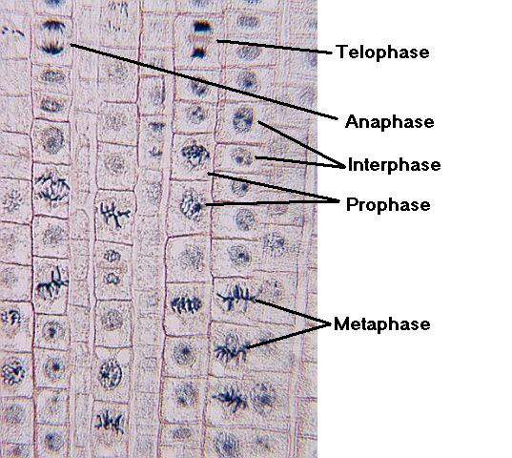

Slide 5
The Cell Cycle and Cancer
benign: non-cancerous
malignant: cancerous
Cancer: uncontrolled cell division due to a mutation – mitosis that doesn’t stop
Cancer cells
lack differentiation
have abnormal nuclei
form tumors

Slide 6
True or False
The vast majority of cancer cases can be prevented.

Slide 7
True!
Researchers estimate that around 85% of cancer
Cases are environmentally related (smoking, diet, chemicals, radiation, Virus). This means only about 15% of cases are genetic.

Slide 8
True or False
Reducing the number of calories is the number one way to prevent cancer.

Slide 9
True!
Studies show that reducing the nutrients your body receives will help keep cancer cells from being nourished.

Slide 10
True or False
Aging is the number one factor in determining whether you will develop cancer or not.

Slide 11
True!
Because as you get older mitosis is a copy of a copy of a copy, the chance of a mutation error increases generally with age.

Slide 12
DO YOU REMEMBER?
Name the phases starting at the top.

Slide 13
2. Name the phase
3. Identify X
4. Identify Y

Slide 14
5. Name the phase

Slide 15
6. Name the phase

Slide 16
10. In humans, each cell (except sex cells) has how many chromosomes? ______
11. After mitosis, how many daughter cells are produced? _______
12. After mitosis (in a human cell), each daughter cell has how many chromosomes? _____
13. How many phases are in MITOSIS? ___________
14. Which phase of the cell cycle is the longest? _________
15. During which phase does cytokinesis begin? __________

