Slide 1
Cell division

Slide 2
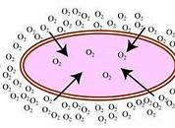
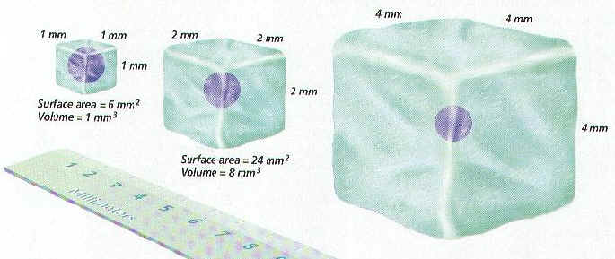
Cell size
Cells must stay very small for 3 reasons…
DNA - larger the cell is the more instructions it needs to function properly.
Diffusion - Slow process. Once the cells volume gets too large nutrients don’t enter the cell fast enough.
Surface area to volume ratio - Once the cell gets too large DNA cannot process the information fast enough for the cell to function properly.
Notes:
Give a brief overview of the presentation. Describe the major focus of the presentation and why it is important.
Introduce each of the major topics.
To provide a road map for the audience, you can repeat this Overview slide throughout the presentation, highlighting the particular topic you will discuss next.

Slide 3
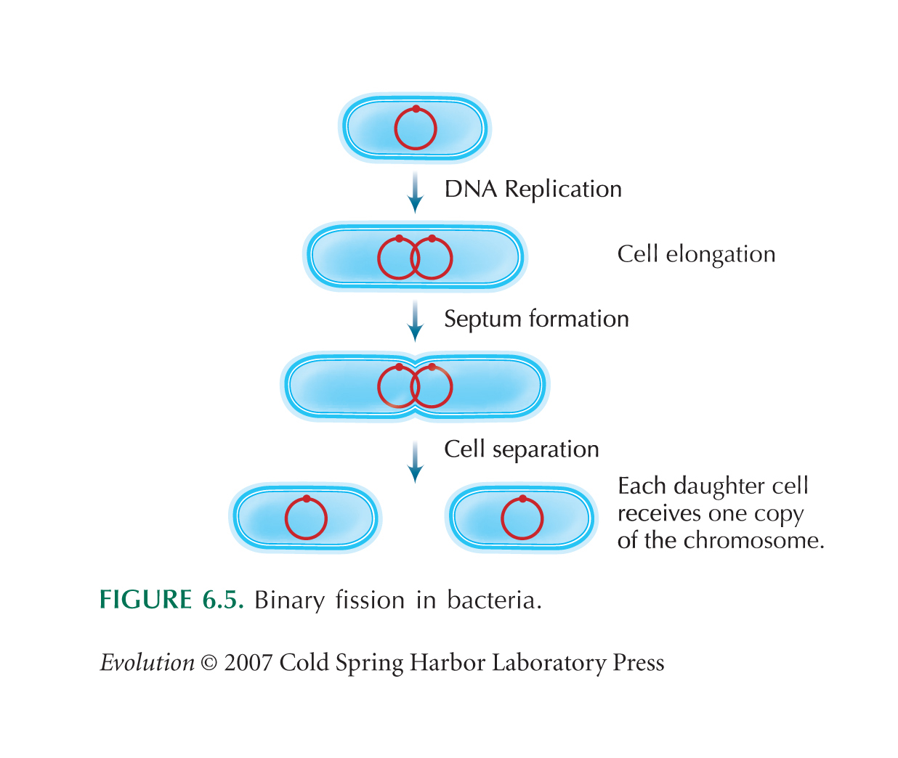
Prokaryotic Cell Division
Bacteria reproduce asexually by binary fission. They copy their genetic material and split in half.

Slide 4
Eukaryotic Cell Division
Chromosomes: condensed strands of DNA
Each species has a specific number
Ex. Homo sapien has 46
Are only visible during mitosis
DNA is usually found as thin, uncoiled chromatin

Slide 5
Why do We Need Mitosis?
Mitosis is asexual: Meaning daughter cells are identical to parent cells.
Source of new cells when a multicellular organism grows and develops.
Without mitosis no living organism would grow and develop!!

Slide 6
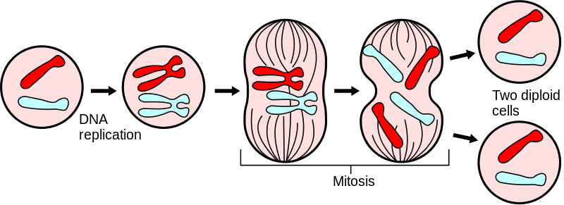
Cell division
In order to grow, our cells must first divide
Each cell goes through a process called:
“The Cell Cycle”
Cells divide into 2 IDENTICAL “daughter” cells

Slide 7
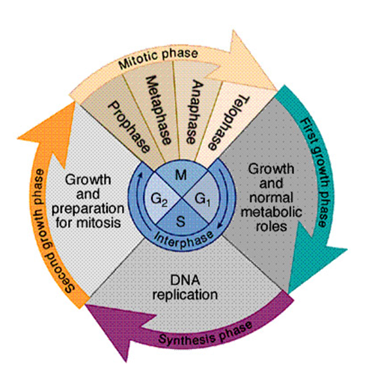
The Cell Cycle
Broken down into
different phases:
1. Interphase
2. Mitosis
3. Cytokinesis
** IPMAT **
Interphase
Prophase
Metaphase
Anaphase
Telophase

Slide 8
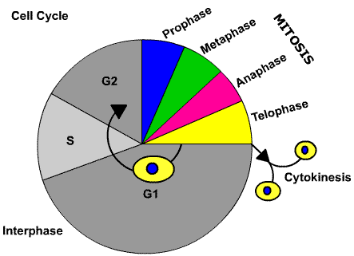
Interphase
Cells grow and mature in this phase (Everyday function of a cell)
-Broken down into 3 parts:
-G1 phase (Growth 1)
-S phase (DNA Replication from 46 to 92 chromosomes in humans!)
-G2 phase (Growth 2)

Slide 9
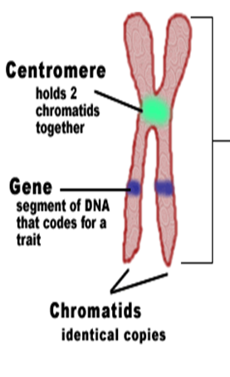
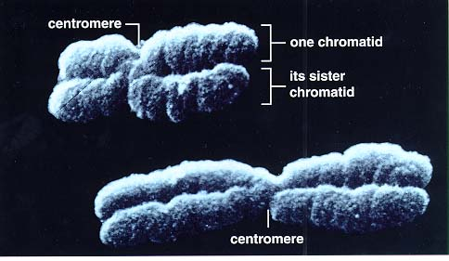
Chromosomes
Made up of DNA (genetic info) & proteins
Consists of 2 identical sister Chromatids
Held together by a centromere
Cells are diploid meaning they have 2 complete sets of chromosomes.
Somatic Cells: skin, muscle, blood

Slide 10
Mitosis

Slide 11
Prophase
1st phase
Centrioles move to opposite ends of the cell
Spindle fibers form
(help separate chromosomes)
Nuclear membrane breaks down and disappears
Chromosomes form & are visible
Note: Plant cells do not have centrioles but still organize their spindle fibers in the same fashion.

Slide 12
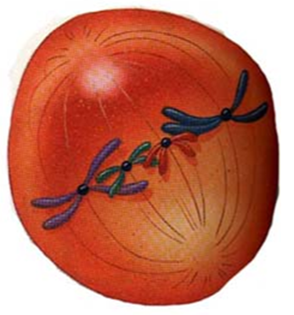
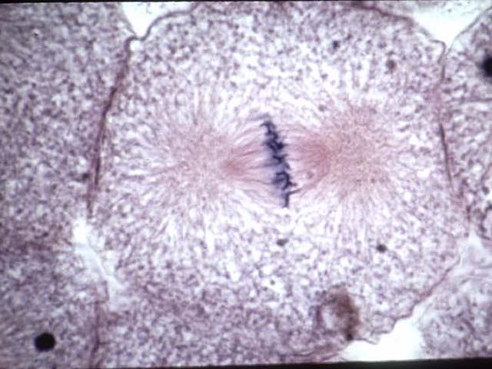
Metaphase
2nd phase
Chromosomes line up along the center of the cell
Spindle fibers attach to the centromere of the chromosome

Slide 13
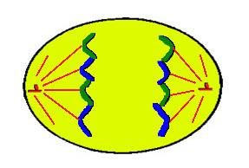
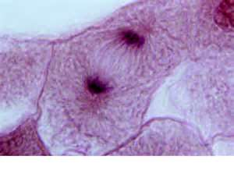
Anaphase
3rd phase
Chromosomes are pulled apart by spindle fibers
Sister chromatids are separated and move to opposite ends of the cell

Slide 14
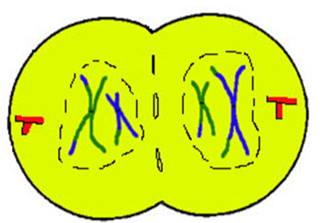
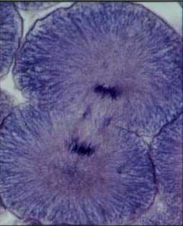
Telophase
4th Phase
Chromatids huddle at opposite ends of the cell
Chromosomes start to return to chromatin(the combination of DNA and proteins that make up the contents of the nucleus of a cell)
New nuclear membrane starts to form around chromatin Cleavage furrow starts to form
END of Mitosis!!

