Slide 1
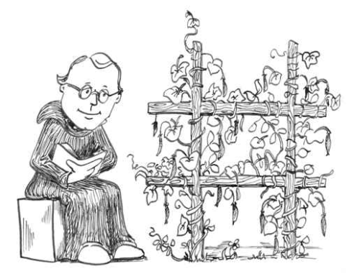
Chapter 11
Introduction to Genetics

Slide 2
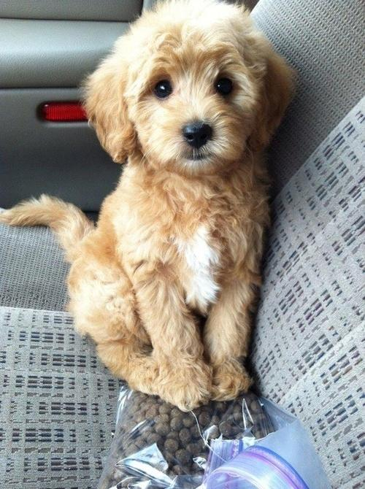
A Brief History
In the past, people did not understand how traits were inherited, but there were many guesses based on things that could be observed.
Golden Doodle

Slide 3
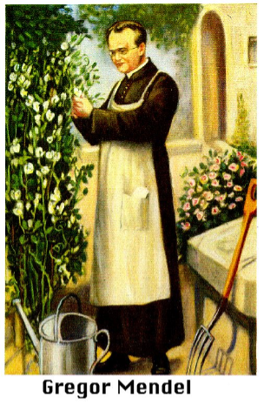
Who was Gregor Mendel?
He was known as the “FATHER OF GENETICS”
He discovered how traits were inherited
GENETICS – study of heredity
HEREDITY – the passing of traits from parents to offspring

Slide 4
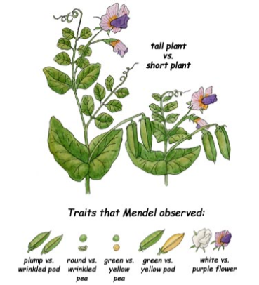
Mendel’s Peas
Mendel did his study on pea plants
which have many traits
tall/short
purple /white flowers
round/wrinkled seed

Slide 5
LITTLE-KNOWN FACT
Some plants have both
sex organs!
Pea plants can be
self-fertilized or
cross-fertilized

Slide 6
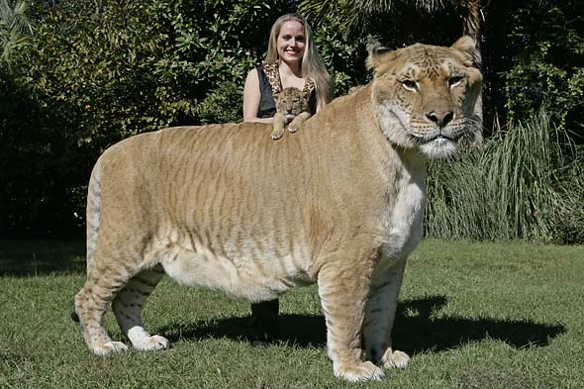
True-Breeding Plants (aka purebreds)-always create plants that look like themselves
Hybrids – offspring with a mixed traits
Tall x Short =
Hybrid

Slide 7
Some traits are dominant over others.
Tall x Short = all tall offspring (hybrids)
*Tall is the dominant trait
* Short is recessive

Slide 8
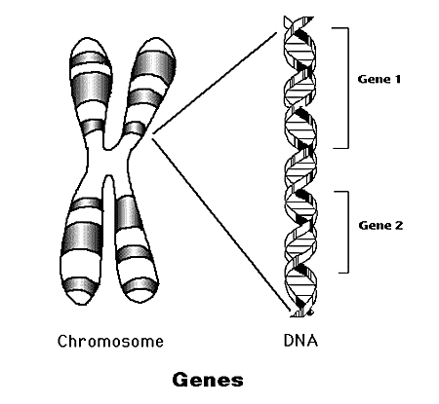
Mendel discovered that each trait is controlled by two factors (alleles)
Genes – factors that determine your traits
Genes are located on chromosomes

Slide 9
Quick Check - What do we know so far?
1. The “Father of Genetics” is ____________
2. Genetics is the study of _____________, which is how traits are passed from _________ to ____________
3. Mendel studied what organism? ____________
4. If one trait covers up another one, we say that it is ______________, the one that is covered up is ______
5. A “true-breeding” plant is one that can only produce plants like itself a) true b) false
6. If a tall and a short plant are crossed, it will create a
a) zygote b) gene c) hybrid

Slide 10
Mendel’s Experiments
Draw the crosses

Slide 11
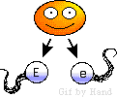
Explaining the Cross
When a parent makes sperm or eggs, their genes separate (PRINCIPLE OF SEGREGATION)
The GAMETES (egg or sperm) contain either a T allele (tall) or a t allele (short)

Slide 12
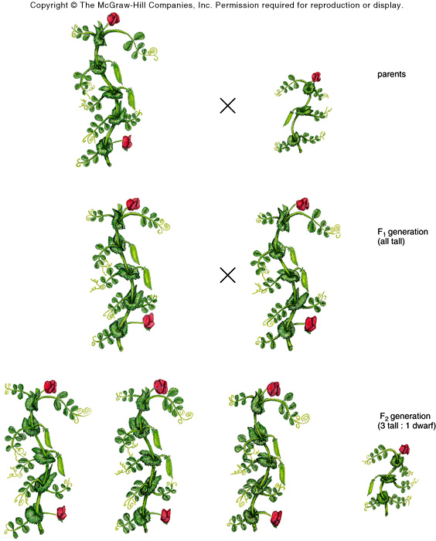

Slide 13
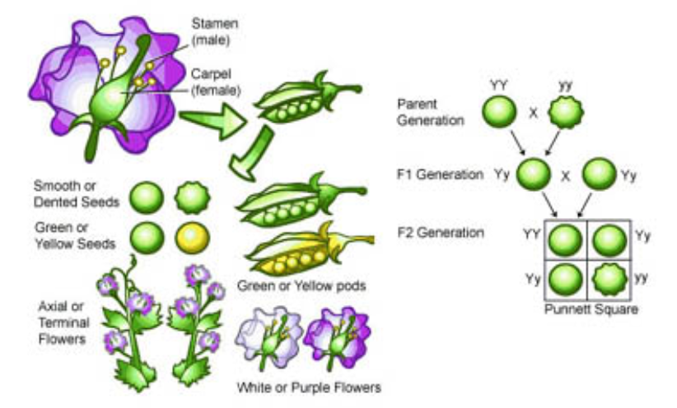

Slide 14
GENOTYPE - what genes, letters, the organism has (TT, Tt, tt)
PHENOTYPE - what it looks like (tall or short)

Slide 15
Check for understanding
1. The passing of traits from parents to offspring is known as ____________________
2. Who was the father of genetics? _________
3. Genes are located on _______________
4. Every gene is made of two
a. genotypes b. alleles c. cells
5. The organism’s outward appearance, such as wrinkled seeds are referred to as the a) phenotype b) genotype

Slide 16
6. The letters (ex. RR) that represent the traits are referred to as the a) phenotype b) genotype
7. An organism that has two different alleles, or letters, such as Rr is: a) homozygous b) heterozygous
8. 7. An organism that has two of the same alleles, or letters, such as RR is: a) homozygous b) heterozygous
9. Which of the following sets would represent Mendel’s Parent (P) generation?
a) RR x RR b) Rr x Rr c) RR x rr
10. When two different alleles occur together, such as R r, the one that is expressed is a) dominant b) recessive

Slide 17
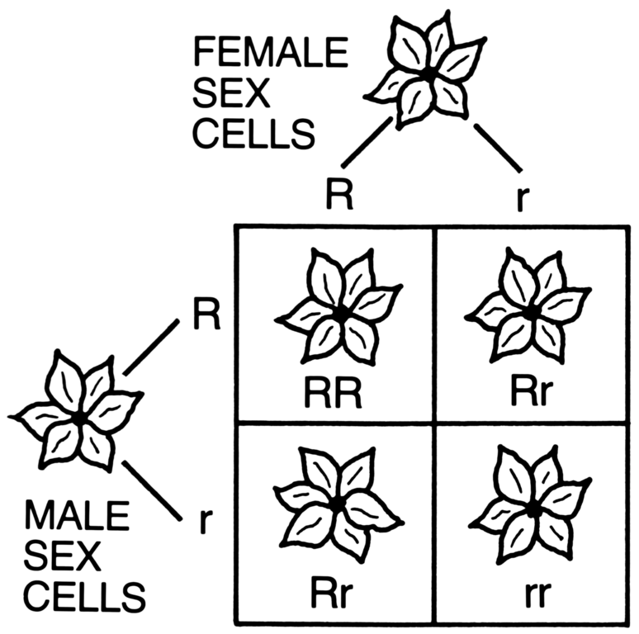
11. What is the diagram shown below called?
What does this letter actually represent?

Slide 18
Check for understanding
1. A one-eyed purple people eater is crossed with a two eyed purple people eater. All of their offspring have two eyes. Which trait is dominant?

Slide 19
2. If you use the letter E for this gene. What is the genotype of the offspring if the parents were EE x ee
3. If you crossed the offspring with each other? How many of the new offspring would you expect to have two eyes?
EE = two eyes
Ee = two eyes
ee = one eye

