Slide 1
Evidence for Evolution
Fossils
Anatomy
Embryology
Biochemistry

Slide 2
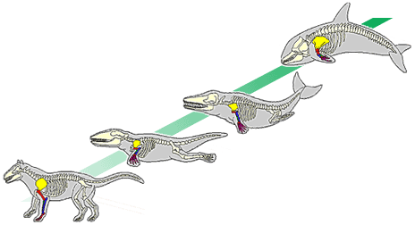
Fossils
Darwin Predicted:
Because new species form from existing species, there should be intermediate stages found in the fossil record.

Slide 3
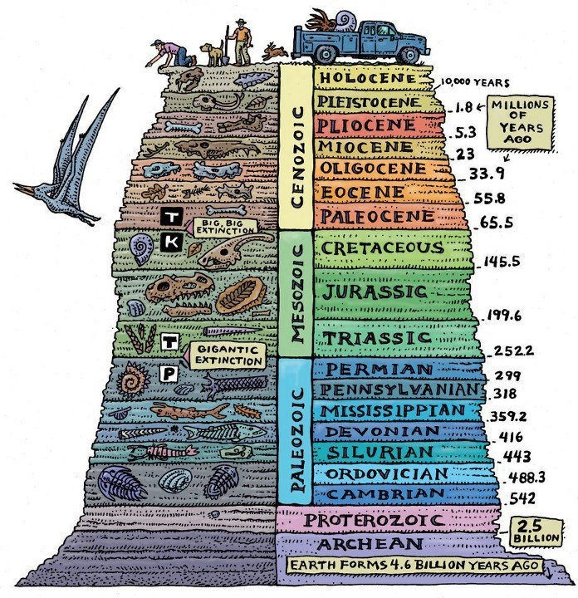
Fossils
Evolution determines
the relative age of fossils
by their depth.
So, the deeper a fossil
is…?

Slide 4
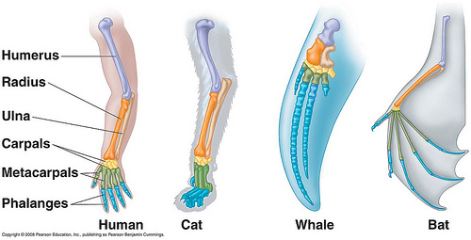
Anatomy
Homologous Structures
Modified structures that show common ancestry
Ex: Forelimb bones in birds and mammals

Slide 5
Anatomy
Analogous Structures
Similar function
No common ancestor
Ex: Fins of fish and whales, Wings of birds and insects

Slide 6
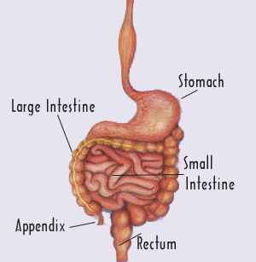
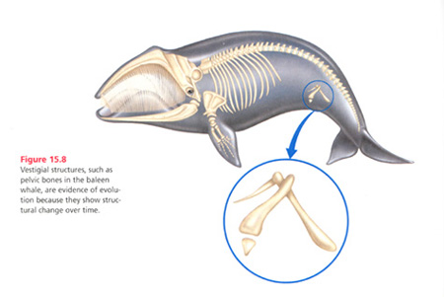
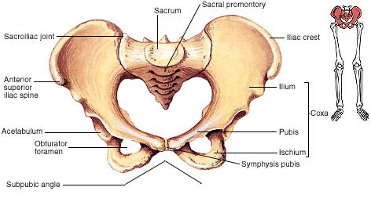
Anatomy
Vestigial Structures
Structures that have no known purpose, but may have functioned in an ancestor
Ex: human appendix, whale pelvic bones

Slide 7
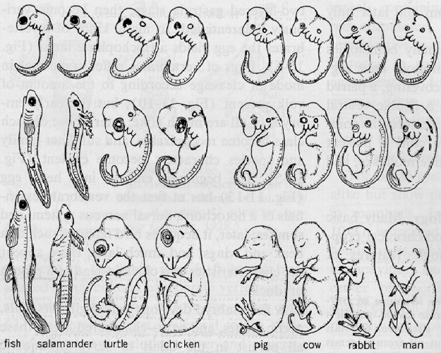
Embryology
Similarities in embryos structure suggest evolution from a common ancestor.
Ex: All vertebrate embryos have gill slits and tails

Slide 8
Biochemistry
DNA sequences can be compared to see how closely related 2 species are.
The more nitrogen base sequences (and PROTEINS) in common, the more closely related.
Chimp = ATT AAG CCA TTA A
Human = ATT AAG GGA TTA A
Bacteria = ATT GGC CAT TAC C

Slide 9
Evolution of Populations

Slide 10
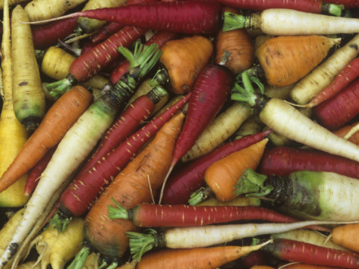
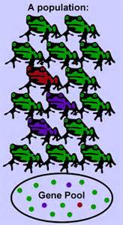
Evolution of Populations
Genetic Variation is the inheritable difference between members of the same species.
Gene Pool is all of the genes present in a population

Slide 11
Sources of Genetic Variation

Slide 12
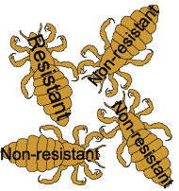
Mutation
Permanent change in DNA

Slide 13
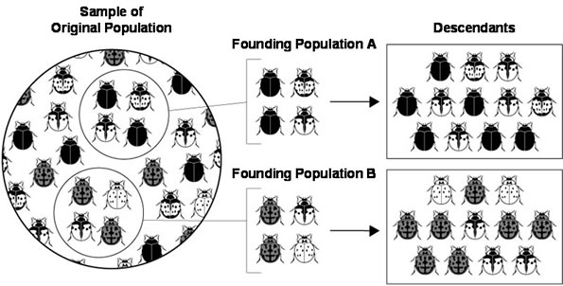
Genetic Drift
Chance events changing gene pools of small populations
WATCH THIS!!

Slide 14
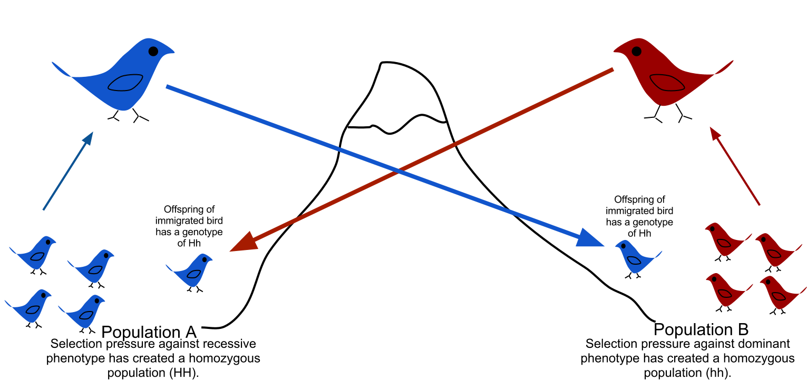
Immigration and Emigration
Movement of individuals into or out of a population.
Changes allele frequencies

Slide 15
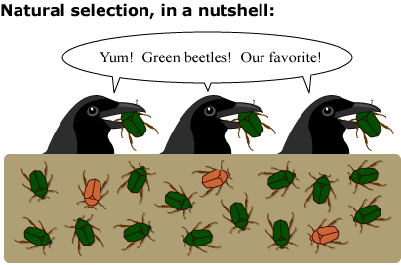
Non-Random Mating
Similar to selective breeding
Only certain traits are desired
Natural Selection

Slide 16
Patterns of Natural Selection

Slide 17
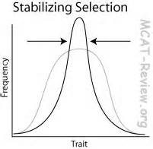
Stabilizing Selection
Selection that favors average individuals in a population.

Slide 18
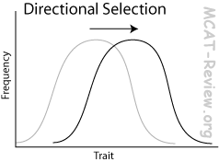
Directional Selection
Selection that favors one of the extreme forms of a trait.

Slide 19
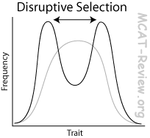
Disruptive Selection
Selection where individuals of both extreme forms are at a selective advantage.

Slide 20
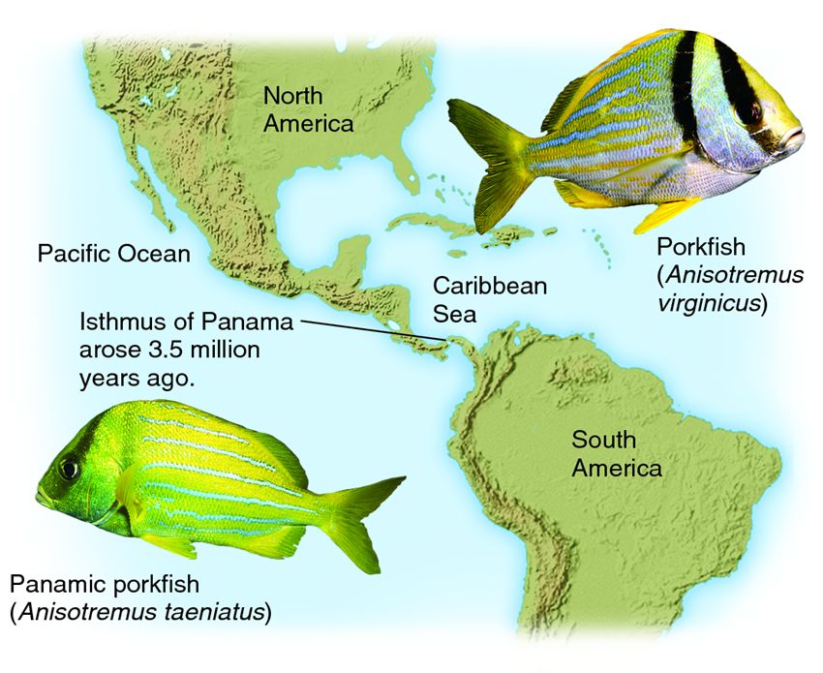
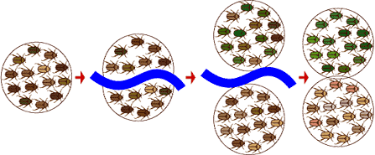
Speciation
Formation of a new species

Slide 21
Species
Group of organisms that can interbreed and produce fertile offspring
Speciation occurs in two ways…

Slide 22
Geographic Reproductive Isolation Isolation
Occurs if a physical barrier separates a population into groups.
Organisms adapt to their isolated enviro
Ex: porkfish
Occurs when formerly interbreeding organisms are prevented from producing fertile offspring
Ex. Insects in different habitats

Slide 23
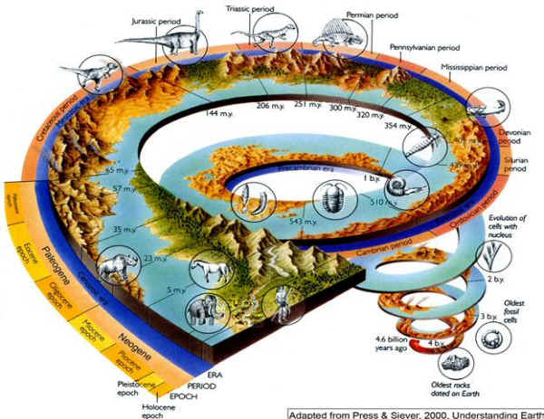
Rates of Speciation
Extinctions have wiped out a large number of species during Earth’s history.
Following these mass extinctions, new species arise

Slide 24
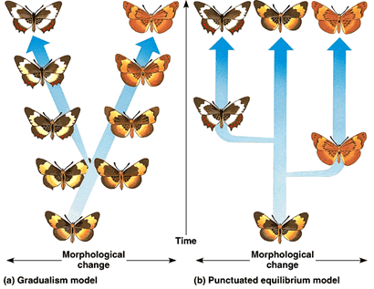
Rates of Speciation
Darwin proposed that evolution was a slow, steady process:
Small adaptive changes accumulate over time
This idea is known as gradualism

Slide 25
Rates of Speciation
Punctuated Equilibrium states that speciation occurs in relatively quick bursts
The bursts seem to occur after extreme environmental changes …AND…
The bursts are then followed by long periods of equilibrium

Slide 26
Patterns of Evolution

Slide 27
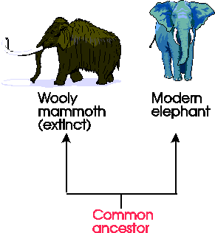
Divergent Evolution
The pattern of evolution in which many different species can be traced back to a common (same) ancestor
Different species adapted to different environments
This is also called adaptive radiation

Slide 28
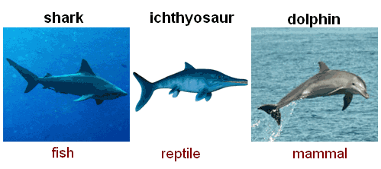
Convergent Evolution
Occurs when distantly related organisms evolve similar traits
The organisms adapted to similar environments

Slide 29
Coevolution
When two organisms evolve in conjunction with each other
Ex. Predators and prey constantly evolving to survive

