Slide 1
Ecology and Energy Transfer

Slide 2
Ecology
The study of relationships that living organisms have with each other and with their abiotic environments
Ecologists study different levels of organization

Slide 3
Levels of Organization
**Species:
Populations:
Communities:
Ecosystems:
Biomes:
Biosphere:

Slide 4
Community Interactions
In a community there is competition between and within species for:
Food
Mates
Shelter/territory
These things become limiting factors.

Slide 5
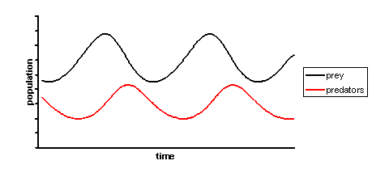
Predation

Slide 6
Types of Symbiosis
Mutualism: both organisms benefit
Parasitism: one organism benefits and the other is harmed
Commensalism: one organism benefits and the other is neither harmed or benefited

Slide 7
Mutualism
Fungi and Algae
Bumble Bee and Flower

Slide 8
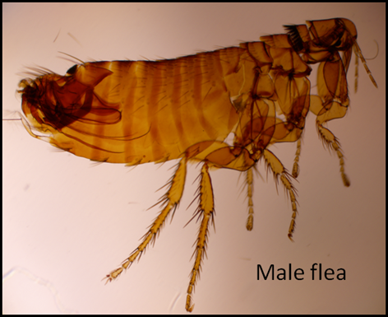
Parasitism
Tick Proboscis

Slide 9
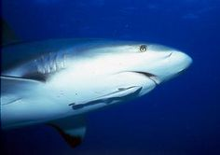
Commensalism
Shark and Pilot Fish
Bird’s Nest in a Tree

Slide 10
Energy
The most important part of a species’ niche is how it obtains energy.
All energy comes from the sun.
2 basic types of organisms
Autotrophs –producers
Heterotrophs –consumers

Slide 11
Autotrophs

Slide 12
Food Chains & Webs
Graphic representations of energy flow in an ecosystem.
The arrows indicate the direction in which the energy is flowing
Food chains are more simple and unrealistic
Food webs are a collection of many food chains – shows relationships

Slide 13
Food Chain

Slide 14
Food Web

Slide 15
Types of Heterotrophs
Herbivores: eat only producers
Carnivores: eat only other consumers
Omnivores: eat both
Scavengers: eat already dead animals
Decomposers: eat organisms by breaking down their organic matter & absorbing the nutrients

Slide 16
Herbivore

Slide 17
Carnivore

Slide 18
Omnivore

Slide 19
Scavenger

Slide 20
Decomposer

Slide 21
Energy Flow
Energy is required for all living systems.
Each step in a food chain or web is a trophic level.
Only 10% of the energy available in transferred to the next trophic level.

Slide 22
Energy Pyramid

