Slide 1
Plasma Membrane

Slide 2
The Plasma Membrane
Outer covering of cell.
Maintains homeostasis (keeps internal environment the same)

Slide 3
The Plasma Membrane
Selectively permeable (sometimes known as semi-permeable)
Only some things can go in and some things can out.
Can you think of something else selectively permeable?

Slide 4
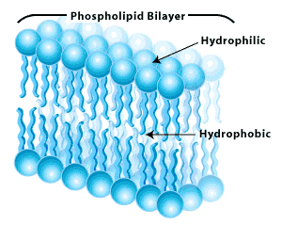
The Plasma Membrane
Is a lipid bilayer (has 2 layers)
Each layer is made of phospholipids:
Head: hydrophillic
Tail: hydrophobic

Slide 5
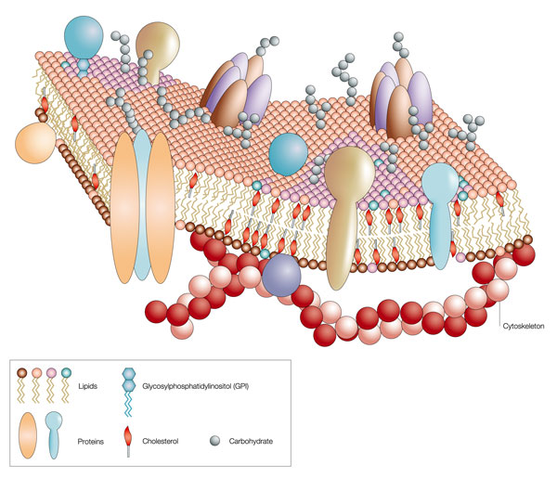
Fluid Mosaic Model

Slide 6
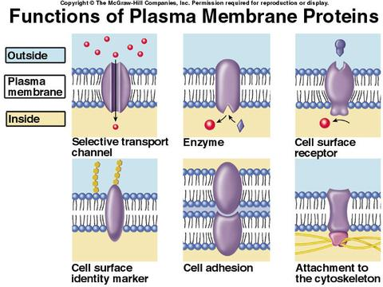
Channel Proteins
Proteins embedded in the cell membrane allow larger molecules to pass through.

