Slide 1
Cells

Slide 2
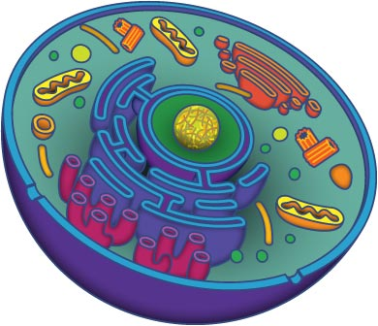
Cells
Cells are the basic unit of life (if something is living, it has cells)

Slide 3
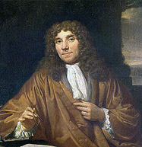
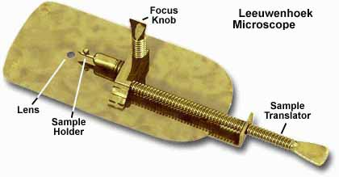
Cell Scientists
Anton van Leeuwenhoek:
1st to see living microorganisms
Use a very simple microscope

Slide 4
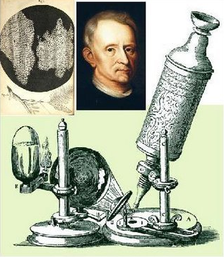
Cell Scientists
Robert Hooke:
1st to see and name cells, “cell”
Looked at cork cells (is cork alive or dead?)

Slide 5
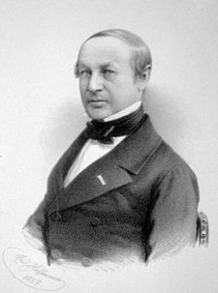
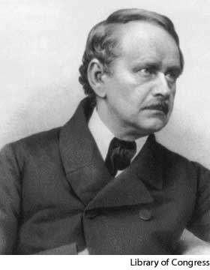
Cell Scientists
Theodor Schwann:
Said that all animals have cells
Matthias Schleiden:
Said that all plants have cells

Slide 6
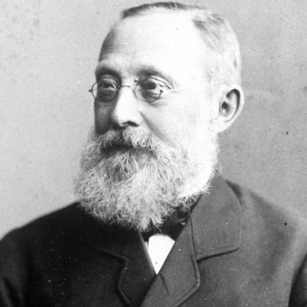
Cell Scientists
Rudolf Virchow:
Based on the work of others, he said all living things are made of cells

Slide 7
Cell Theory
All living things are made of one or more cells
Cells are the basic unit of structure and function
All cells come from other living cells

Slide 8
Types of Cells
Prokaryotic | Eukaryotic
Simple, smaller | Complex, larger
No nucleus or membrane-bound organelles | Has a nucleus and organelles
Original source of all life, according to evolution | Thought to have evolved from prokaryotes
Ex. Bacteria | Ex. Humans, dogs, trees, fish, jellyfish, grass

Slide 9
Types of Cells
Plant | Animal
Squareish and boxy | Roundish (mostly)
Cell wall made of cellulose and large vacuole to hold water | No cell wall and smaller vacuole
Chloroplast for photosynthesis | No chloroplast
Ex. Daisies, Roses, Grass, Trees | Ex. Humans, tigers, whales, rats

