Slide 1
Osmosis & Cell Transport

Slide 2
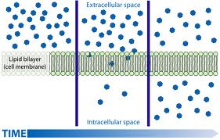
Diffusion
Movement of particles from HIGH to LOW concentration.
Caused by a concentration gradient (difference in concentration).
Stops when it reaches dynamic equilibrium (equal amounts everywhere).

Slide 3
Osmosis
Movement of water across a semi-permeable membrane from high water concentration to low.
Always associate osmosis with water!
Water rule:
Water always wants to go where the parti(cles) is at.

Slide 4
Osmotic Solutions
Solution | Direction of Water | Result in Animal Cell | Result in Plant Cell
HypOtonic:
Hyp_{e}rtonic:
Isotonic:

Slide 5
Too much water?
Plant cells do not burst because of their cell wall.
Plants like being in a hypotonic solution.
Distilled water is extra pure and can cause our blood cells to burst. Do not drink!

Slide 6
Cell Transport
Passive: movement from HIGH to LOW
No energy added
This happens naturally
Active: movement from LOW to HIGH
Energy REQUIRED!!
This is against the concentration gradient

Slide 7
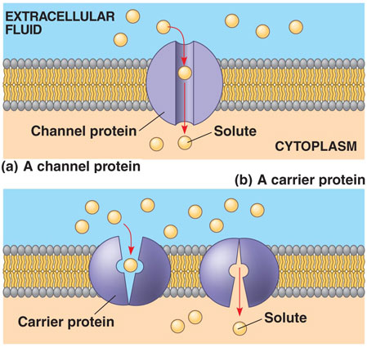
Passive Transport
Does not require energy from the cell
3 Types:
Diffusion
Osmosis
Facilitated Diffusion=larger particles diffuse through channel proteins in the cell membrane

Slide 8
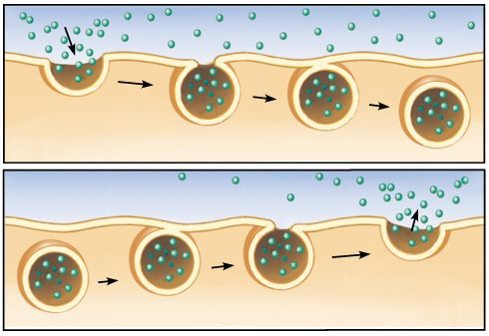
Active Transport
Requires energy from the cell.
Moves material against the concentration gradient.
3 Types:
Pumps=carrier proteins move materials from low to high concentration
Endocytosis=cell membrane surrounds materials to bring them into the cell
Exocytosis=vacuoles fuse with the cell membrane to move materials out of the cell

Slide 9
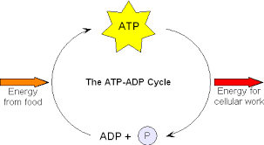
Energy
The energy that cells use is ATP (adenosine triphosphate). ATP is made of ADP and a phosphate. When ATP is made energy is stored up. When a bond breaks energy is released.

Slide 10
Intracellular | Extracellular | Hypo, hyper, iso | In or out
5% salt 95% water | 10% salt 90% water
10% salt 90% water | 10% salt 90% water
3% glucose 97% water | 1% glucose 99% water
2% protein 98% water | 1% protein 99% water
9% Salt 91% water | 9% salt 91% water
13% water | 25% water
59% water | 45% water
90% water | 92% water
74% glucose 26% water | 87% glucose 13% water

